Slide 1

Power Analysis
How many samples do we need?
Sili Fan WCMC statistician

Slide 2
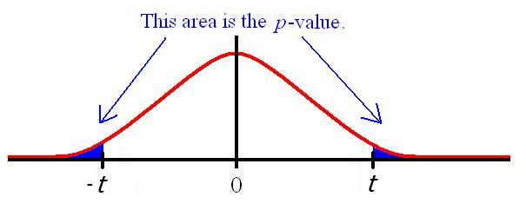

Power
The chance of detecting a significant result.
Large Enough:
If there is an effect of a size worth knowing about, the study will find it significant
But not unnecessarily large!
Too large: waste time, samples (animals), resources
Too small: low chance of detecting result, almost whole experiment wasted
$$t= \frac{x_{1}−x_{2}}{S}×N$$

Slide 3
Power analysis/Sample size estimation is not always necessary
Pilot study
To check experimental procedures
To obtain estimate of variability prior to full study
Anytime you are not making a statistical inference

Slide 4
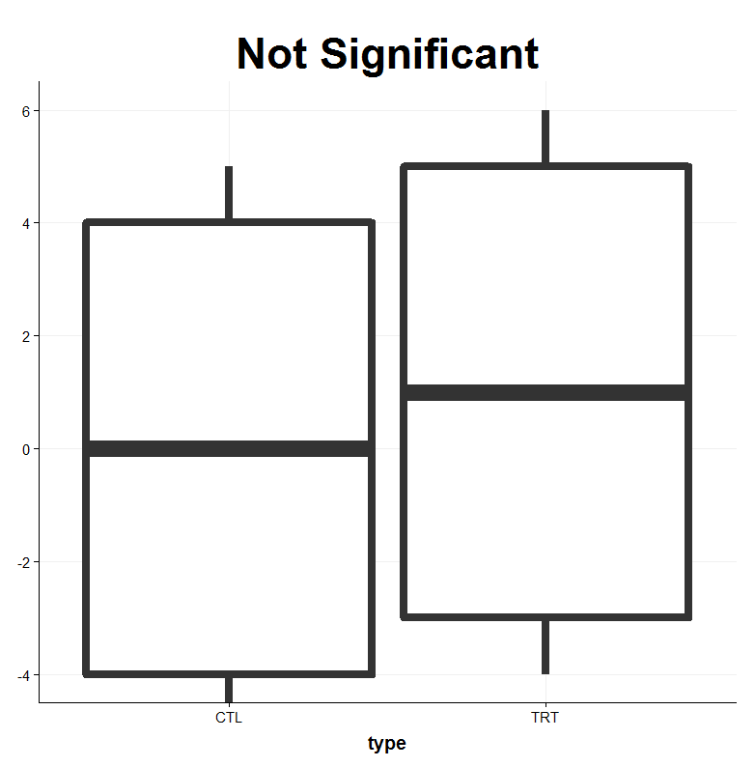
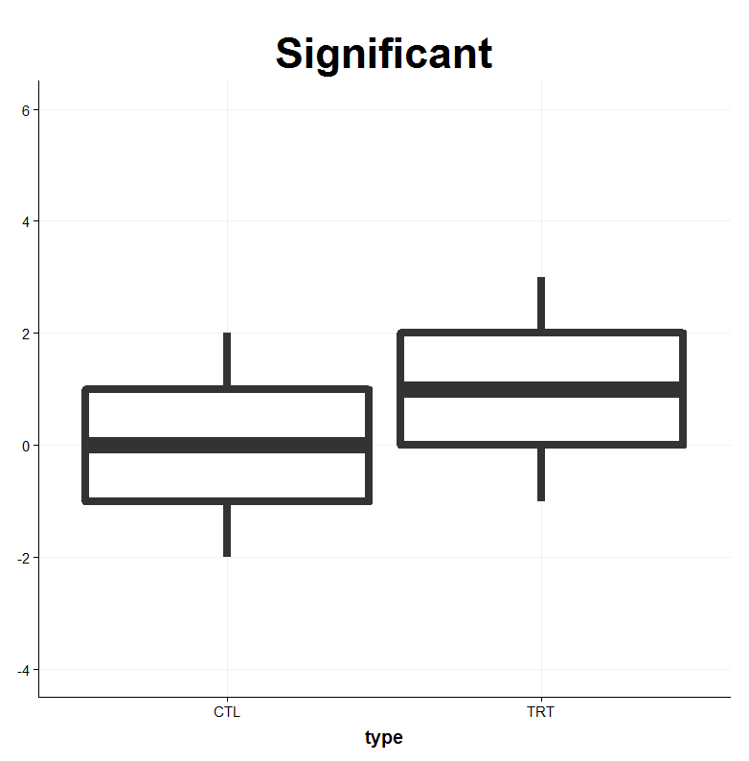
Sample size – basic formula
Calculate it such that there is a good chance of achieving the study objectives
Depending on several factors
Size of difference (delta): to detect, minimum effect of interest: a 50% decrease in metabolite
Significance level (alpha): 0.05
Power (beta): chance of detecting a significant result if three difference is delta: 80% or 90%, but not 50%!
Standard deviation (SD = sigma) of data (variability)
variability
signal

Slide 5
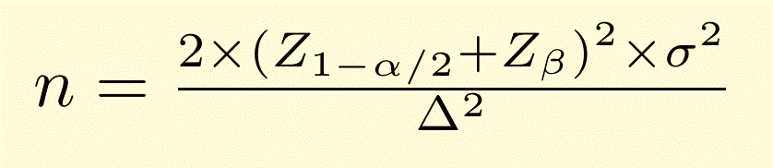
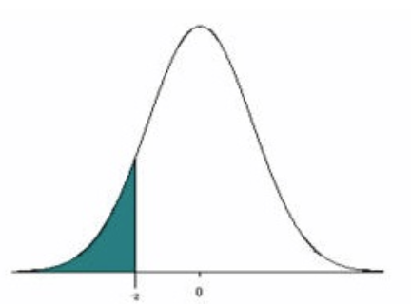
Sample size – basic formula
p
Z_p
Delta = size of the difference, minimal effect of interest
Alpha = significant level (0.05)
Beta = power, probability of detecting a significant result (typically 80%, 90%)
Sigma = SD of data
Z_p = points on normal distribution to give required power and significance

Slide 6
Sample size – basic formula
p
Z_p
Most suitable for data assumed to be (able to be transformed to be) normally distributed
Non-normal continuous data:
Transform your data into ‘more’ normal
no ideal formula
above formula often suitable as it tends to be conservative (mathematically)
non-parametric tests: difficult for power analysis. Rely on computer simulation.

Slide 7



Z-values (normal distribution)
p
Z_p
Values frequently used:
5% significant level (two tails):
80% of statistical power:
90% of statistical power:

Slide 8
Example 1
To determine how many mice to test the effect of chloram on red blood cell count.
Objective: compare control and active injections (treatment group)
Inputs for calculation:
Delta = size of the difference, minimal effect of interest = 0.5
Alpha = significant level (0.05) => z-score = 1.96
Beta = probability of detecting a significant result (80%) => z-score = 0.84
Sigma = SD of data = 0.39
=> n = 9.53 => rounded to 10
“With a sample size of 10 mice per group, and a true mean difference in red blood cell count of 0.50, there is 80% power to obtain a statistical significant difference between treatment groups at the 5% significant level”
Past data from a control group
RBC
7.85
8.77
8.48
8.22

Slide 9
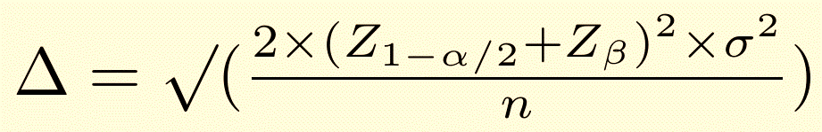
Only 12 mice are available?
- Effect size
In terms of minimum difference in RBC to be detected (Delta) = 0.63

Slide 10
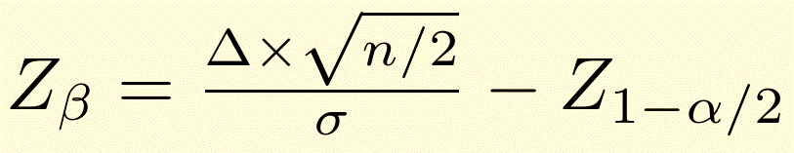
Only 12 mice are available?
- Power
In terms of difference in RBC to be detected (Delta) at 0.5, the Z_beta = 0.26 => beta (power) = 60%
60% of chance of detecting a different of 0.5 using 6 mice.

Slide 11
Relationships
Sample size (n)
Power (beta)
Difference can be detected
SD of data
Significant level: 0.05
But usually, the sample size is the goal.

Slide 12
Find out what sample size would be needed in terms of size of difference detected (delta)
Difference detected (delta) | power
 | 80% | 90%
0.2 | 60 | 80
0.4 | 15 | 20
0.6 | 7 | 9
0.8 | 4 | 5
1.0 | 3 | 4
20 mice needed to give a 90% power of detecting a difference in RBC of 0.4

Slide 13
Power calculation: Find out power of studies with varying sample size (n) and effect differences (delta)
Mice per group (n) | Effect size of interest (delta)
 | 0.2 | 0.4 | 0.6 | 0.8
5 | 13% | 37% | 68% | 90%
10 | 21% | 63% | 93% | 100%
15 | 29% | 80% | 99% | 100%
20 | 37% | 90% | 100% | 100%
68% power of detecting a difference of 0.6 in RBC if 5 mice per group

Slide 14
Pitfalls
The power of a study calculated retrospectively (aka post-hoc power analysis)
Can be useful to know if study is under-powered when interpreting a non-significant result? –The effect may be real but that there were too few subjects in the study?
Post Hoc Power Analysis: An Idea Whose Time Has Passed?
Marc Levine Ph.D. Mary H. H. Ensom Pharm.D., FASHP, FCCP
https://onlinelibrary.wiley.com/doi/epdf/10.1592/phco.21.5.405.34503

Slide 15
Find out size of difference detectable in RBC (delta), based on varying sample sizes
Mice per group (n) | power
 | 80% | 90%
5 | 0.69 | 0.8
10 | 0.49 | 0.57
15 | 0.40 | 0.46
20 | 0.35 | 0.40
A minimum of 0.46 difference in RBC may be detected with 90% power with 15 mice per group

Slide 16
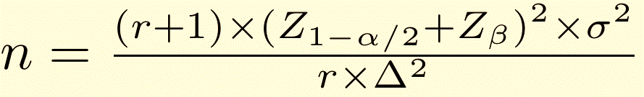
Different number of samples per group?
Sample size for smaller group
Suppose it is desirable to limit numbers treated with Chloram
Assume that we would like to have twice as any mice in control group as Chloram group.
Set inputs for calculation:
r = ratio of number in larger group (control) to smaller group = 2
Delta = size of difference, minimal effect of interest = 0.5
Alpha = 0.05 => z score = 1.96
Beta = 80% => 0.84
Sigma = SD of data = 0.39
=> n = 7.14 => 8
Now 8 + 16 = 24 mice in total
- compared with 20 mice (10+10) in original design with equal numbers per treatment

Slide 17
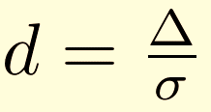
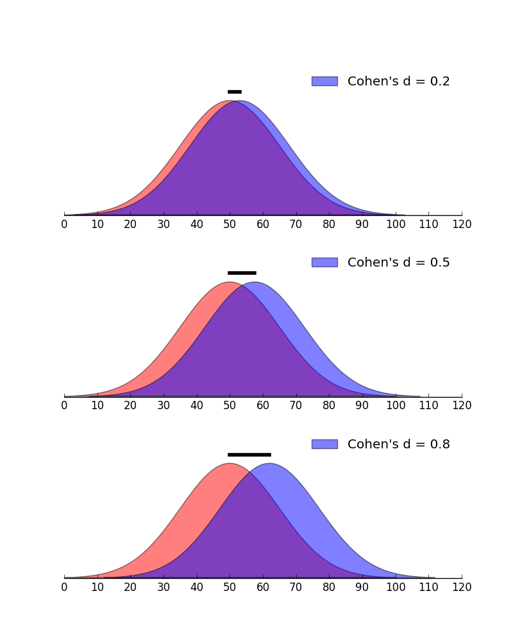
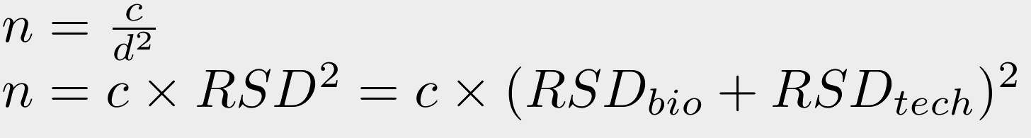
Sample size optimization – increase effect size
Metabolites are in different scales
Cohen suggested that d=0.2 be considered a 'small' effect size, 0.5 represents a 'medium' effect size and 0.8 a 'large' effect size.
When estimating the effect size, take the technical variation into account.
Increase effect size during sample preparation.
Correct the technical variation at data processing.
“smarter” study design

Slide 18
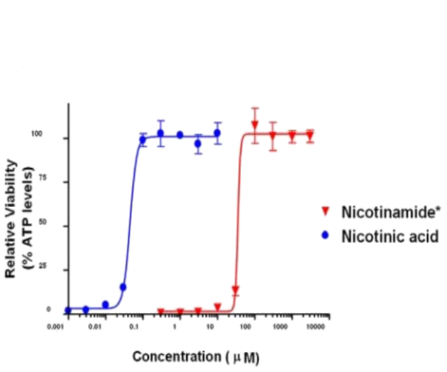
What affects the effect size?
Difference
Sample Size
Effect Size
=
Variation
Increase the Difference
Design Your Study to Collect Adequate Exposures
“Exposures” refers to dose or time. Multi-exposure point studies, such as a time-course study or a multi-dose study, increases your chance of seeing meaningful variations.
A good rule of thumb is to collect samples at a “mild”, “moderate” and “severe” exposures to ensure that all salient cause and effect changes are captured.

Slide 19
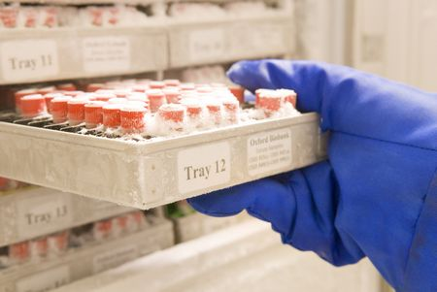

What affects the effect size?
Difference
Sample Size
Effect Size
=
Variation
Decrease the Variation
sample collection variation
consistent in sample collection and handling is essential
Temperature,
Aliquoting,
Biobanking,
Multiple people involved in data processing,
Multiple machine,
…
In a case-control study, an 5% of standard deviation increment for a metabolite with a small effect size (Cohen’s d = 0.2) would need 41 more samples to achieve an 80% of statistical power

Slide 20
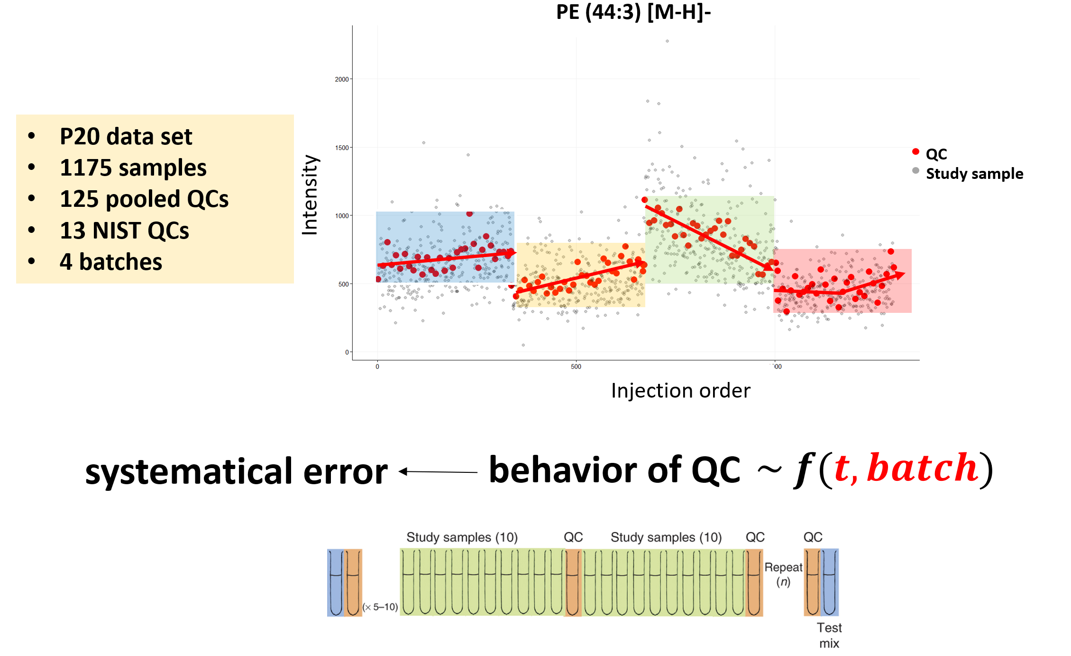
What affects the effect size?
Correct the technical variation
The more variation you can control for, the less samples are required. The less variation you can control for, the more samples you need to overcome the variation.

Slide 21
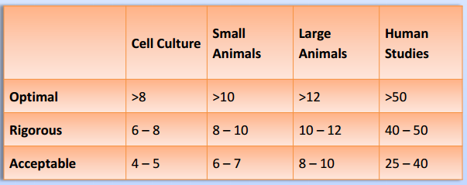

What affects the effect size?
Difference
Sample Size
Effect Size
=
Variation
the inherent variability in the model/cohort under study
gender, BMI, age, race, lifestyle, …
cell
small animals
large animals
human
confounder
repeated measure?

Slide 22
Tips for sample size calculation
Understand if the treatment effect are dramatic and subtle
Rule of thumb
Estimate the effect size with pilot study (or from previous work)
Power analysis tools:
G * Power
MetDA – power analysis
Metaboanalyst – Power Analysis

Slide 23
*Disclaimer What about the optimal sample size for Multivariate Analysis?
We only talked about sample size for one compound (Univariate Analysis)
Multivariate Analysis: Optimal sample size is not clear.
As rule of thumb, use 10 observations per parameter.

